Slide 1
Partial Return Yoke
(Magnetic Shield)

Slide 2
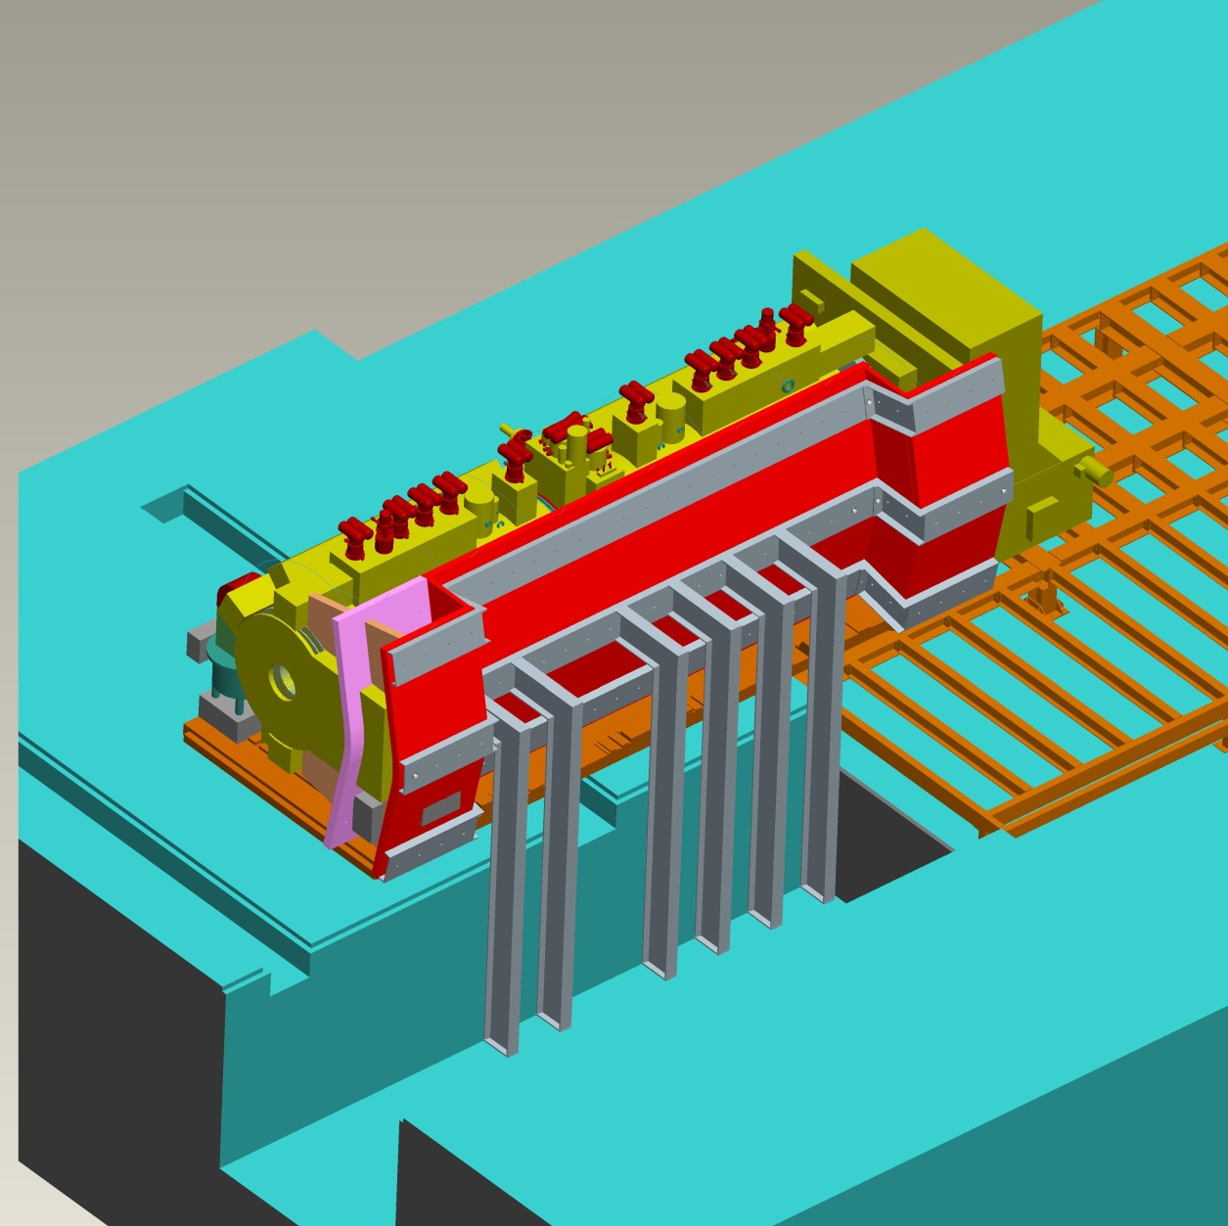
Modular shielding
Need for shielding:
  Large stray field in MICE hall
  MICE Hall: equipment which is sensitive to field
UK/US magnetic Shielding Group
  Two approaches: individual shielding of components and magnetic shield
BNL: Magnetic Shield
  Design and simulation effort
  Shield:
  40 tons of iron, 8.5m long
  Mechanical design (Magnet Division)
Same shielding on this side
except floor mounting method
Courtesy of Steve Plate, BNL

Slide 3
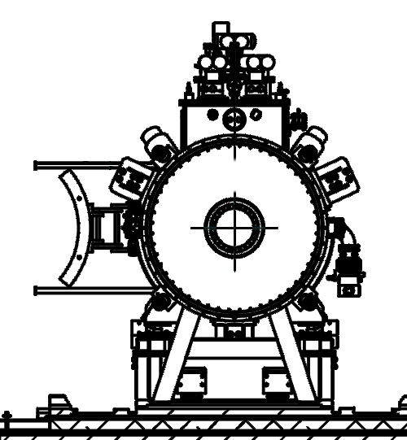
Concept
For perfect shielding: encase MICE in soft-iron cylinder
  Not practical
However: acceptable shielding can be obtained with “partial return yoke”
Geometry
  Tube of radius 1.2 m
  wall thickness 10 cm
  azimuthally -50..50°
  weight: 30t
1.5 m
R1.2
2 m
(Note: not to scale)

Slide 4
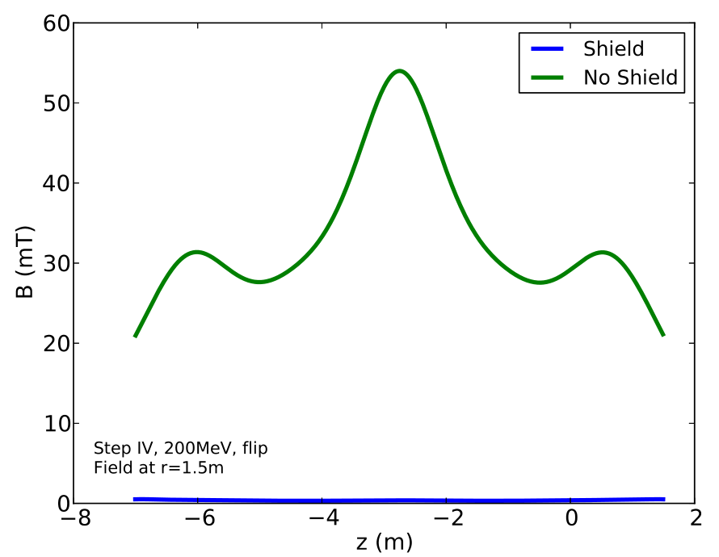
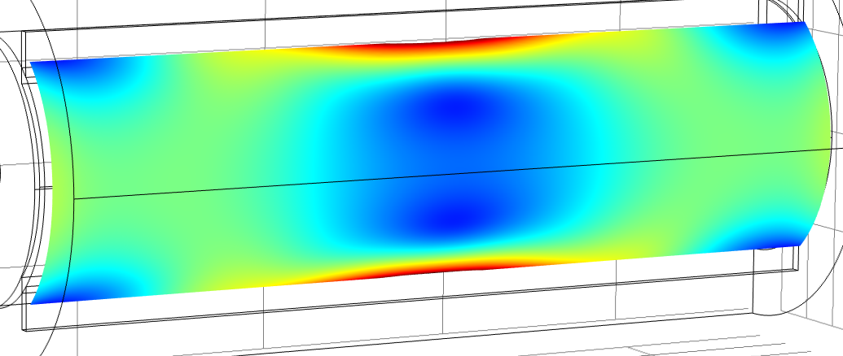
Achievable Performance
Flux leakage contained closely to MICE
  Very little field leakage behind shield
Field smaller than 5 Gauss for large fraction of MICE hall
Tracker electronics in low field region
First pass on engineering design
Field lower by
factor 40+
10G
5G
2G

Slide 5
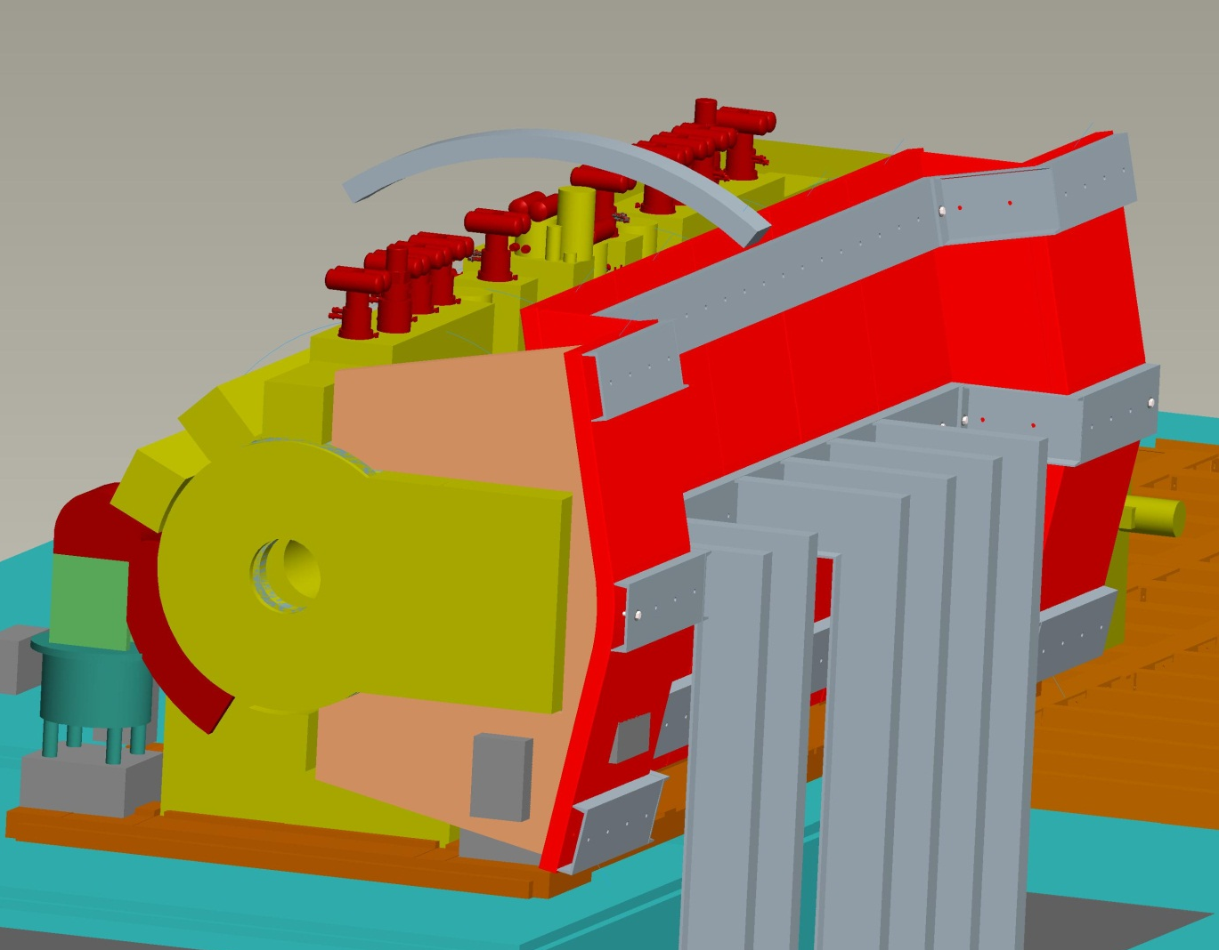

Progress
General Concept and Performance
  All cases of MICE
Shield Penetrations
  Required for tracker waveguides etc.
  Solution identified – no impact on performance
Engineering
  Integration with MICE hall feasible
  Forces on shield evaluated
  Floor loadings / support structure
  Preliminary cost-efficient engineering concept: shield made of 14 sections
Extension to Step VI
  Demonstrated: general proof-of-concept simulation
  More detail work necessary (focus is on Step IV)
Section of shield made of AISI 1010 steel
2920mm
[115 in]

