Slide 1
Aims of modelling in R9
General validation of model
What fields are the compressors operating in?
What is the most accurate way to model compressors?
What effect does the partition wall have on the field?

Slide 2
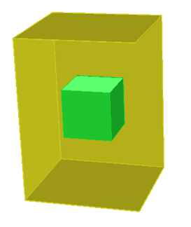
General Validation
2mm “mildaverage” steel
Baseline compressors modelled
Compare the field maps at an array of points in R9 (49 points)
This model has been built.
135kg

Slide 3
What field are the compressors operating in?
The modelling done so far predicts that the field around the compressors is ~5 Gauss, and that develops a field in the skin that is ~200 Gauss.
However, the Cryogenics group have experience of have operating compressors in similar fields in R9 previously.
We need to measure the real field to see if the compressor skin is shielding the motor or if it is just operating ok in that field.

Slide 4
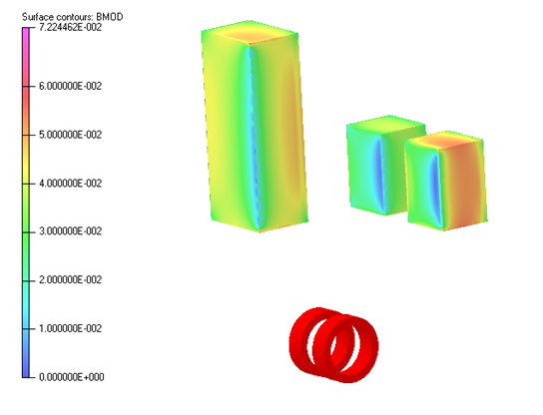
What is the most accurate way to model compressors and racks?
Model compressor in variety of ways:
Single lump mass
Skin with simple mass in centre
Evenly distributed mass
9 lump masses (8 corners and the centre)
Etc.
Measure field in and around compressors and control racks
Compare which model most accurately predicts fields
This is future work.

Slide 5
What effect does the partition wall have on the field?
The partition wall has been modelled in a similar way to those in the MICE hall
Measuring the field in and around the wall will give us more confidence in our modelling techniques.

